Slide 1
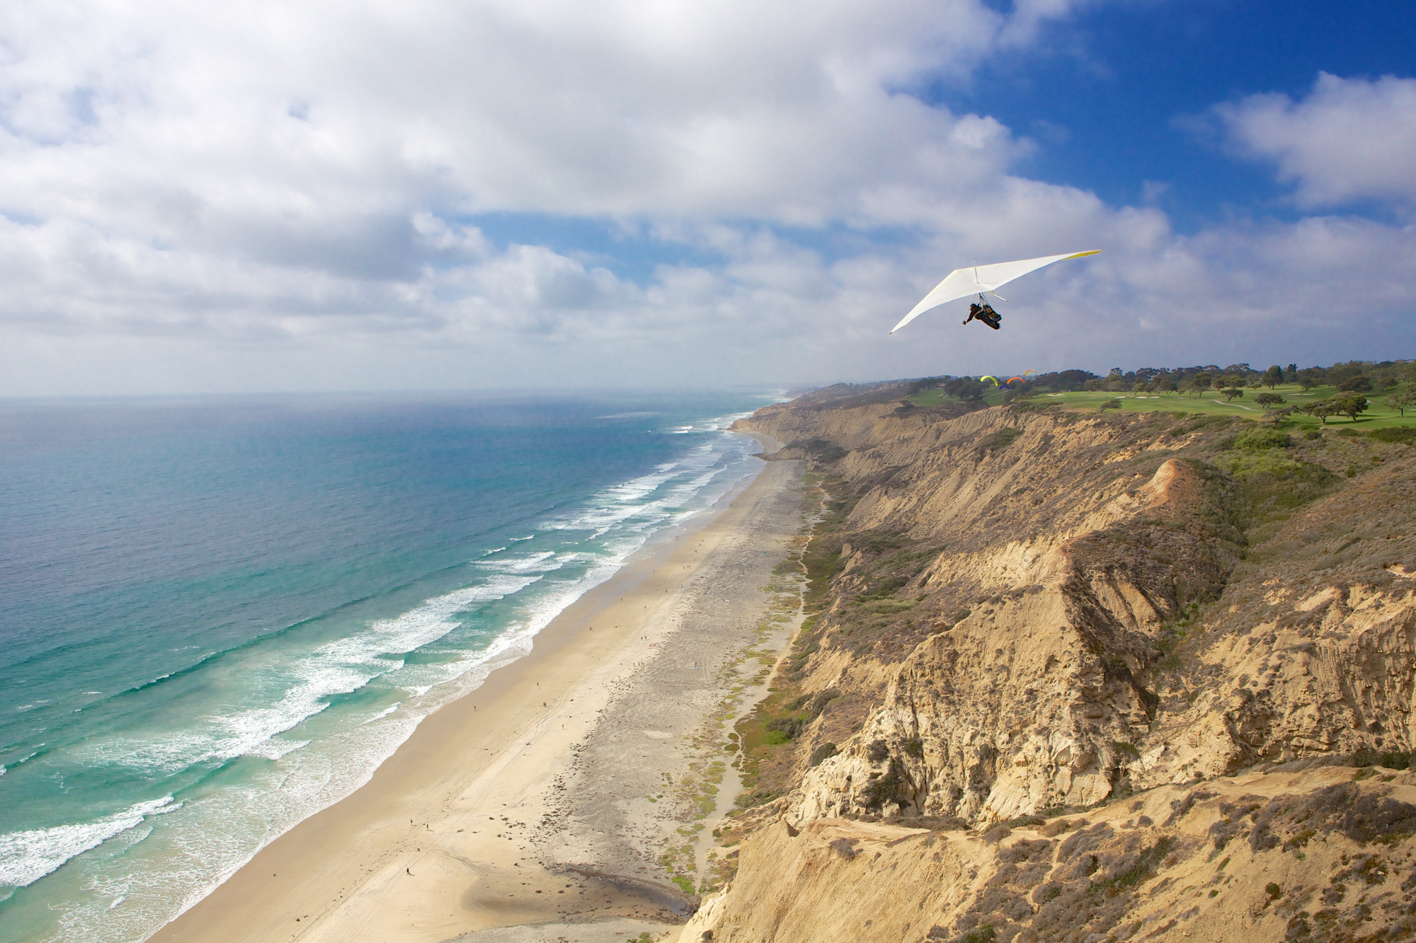
Notes:
Torrey Pines, San Diego County. Photo by Della Huff

