Slide 1
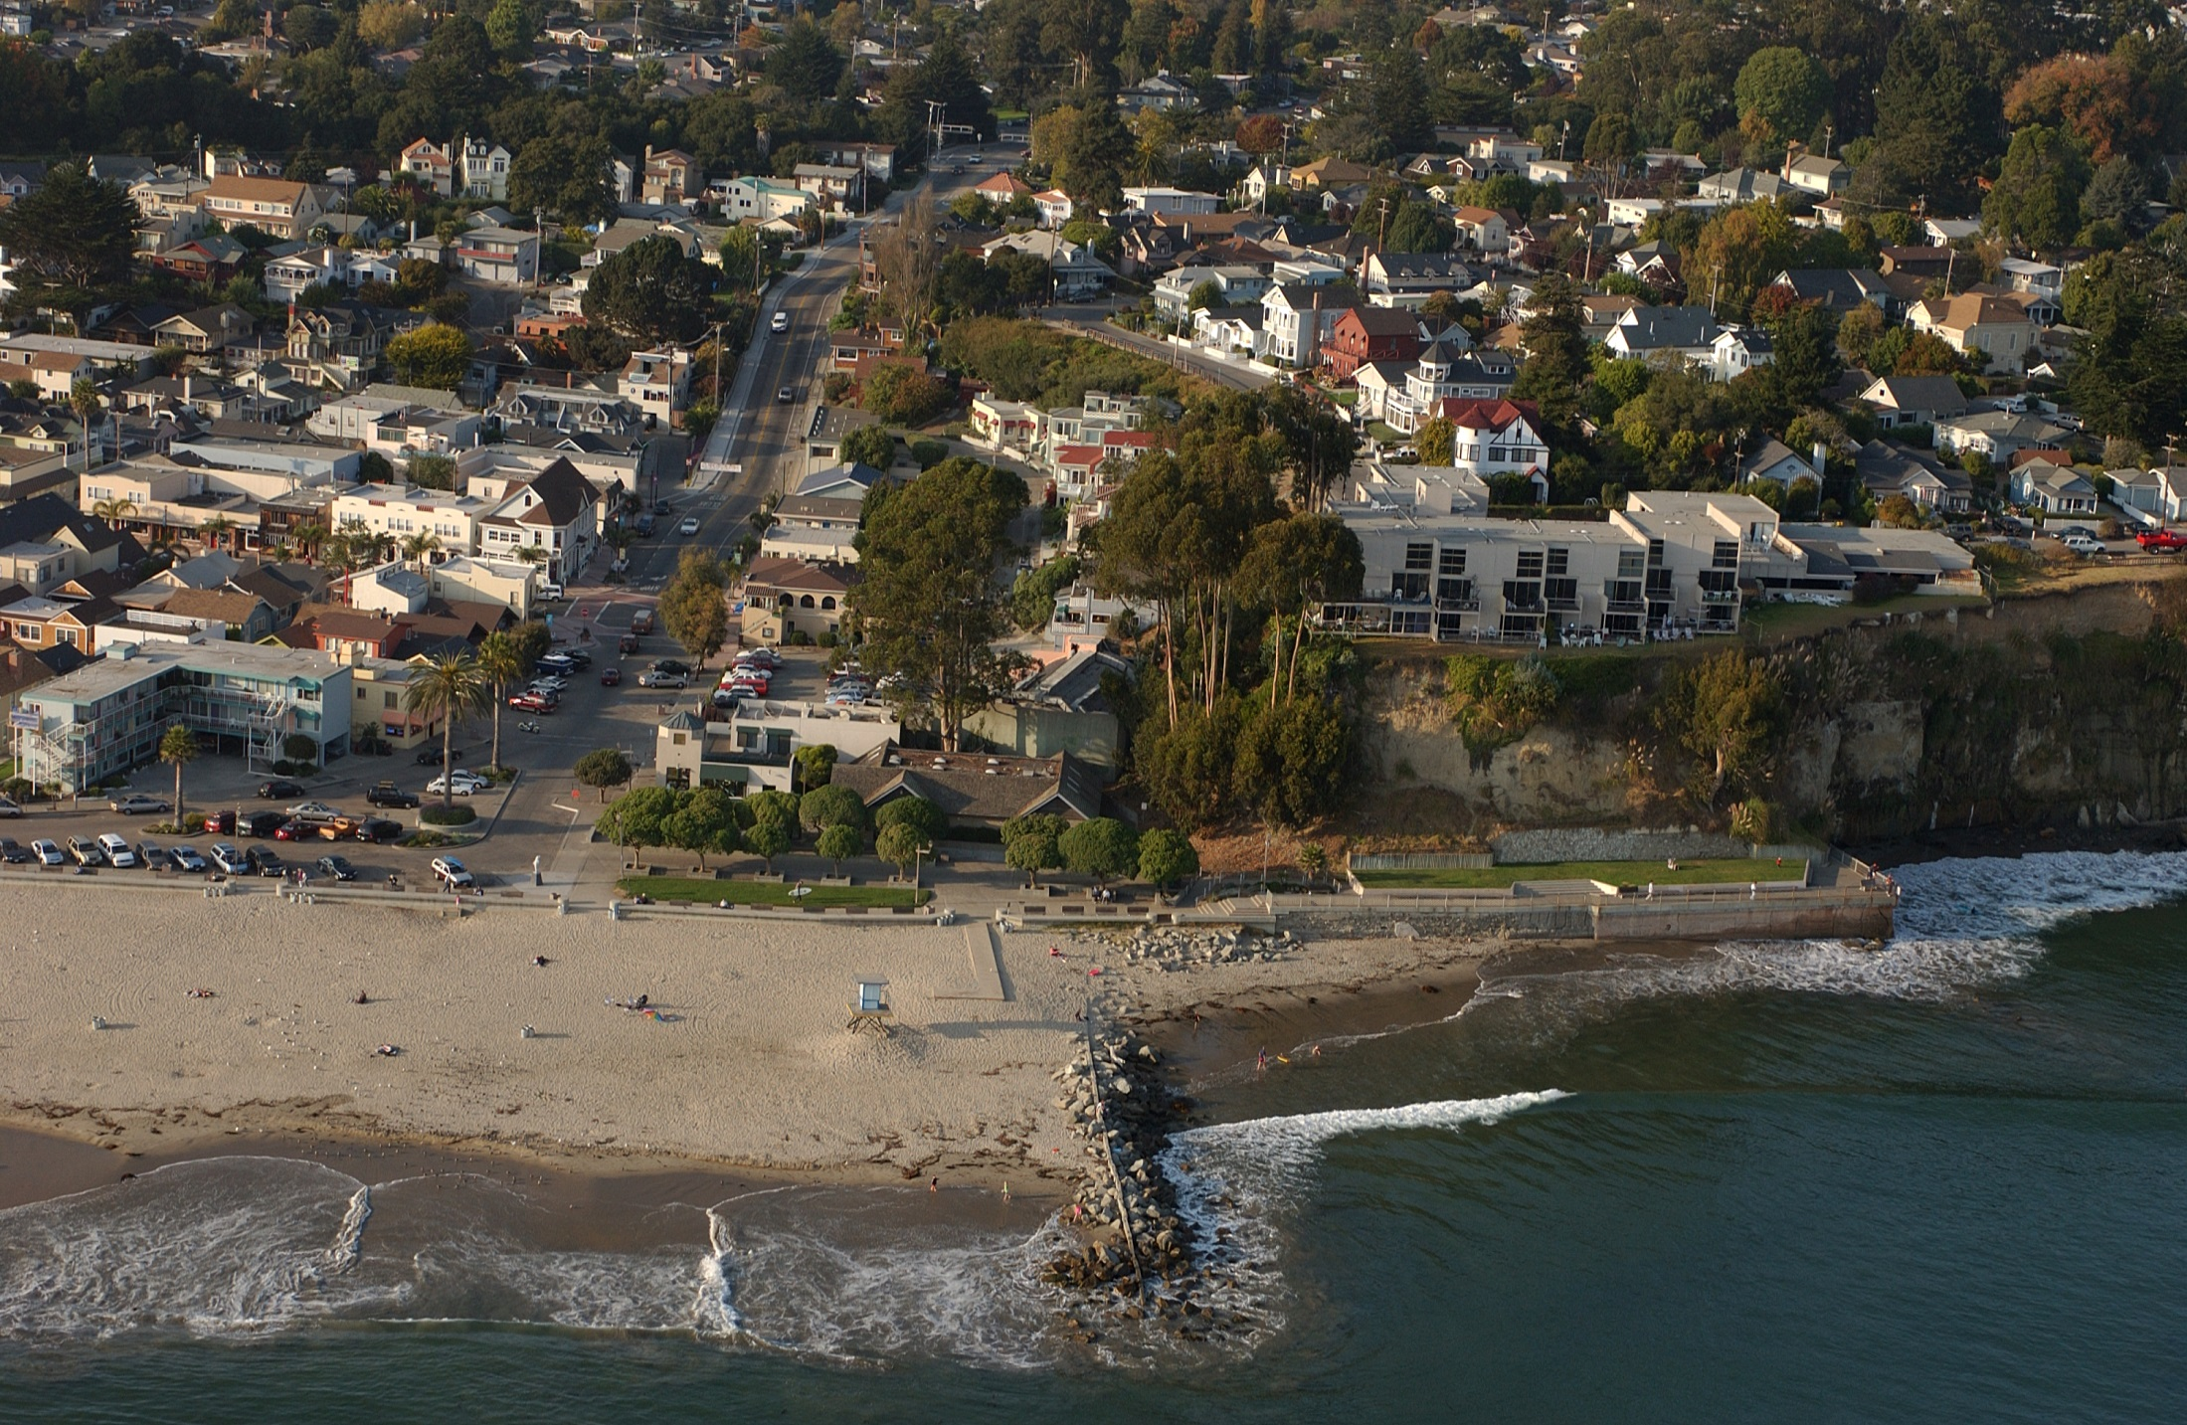
Notes:
Capitola Beach, Village, and Jetty. Copyright (C) 2002-2014 Kenneth & Gabrielle Adelman, California Coastal Records Project, www.californiacoastline.org

