Slide 1
Why Plastic Bottle Caps Matter

Slide 2
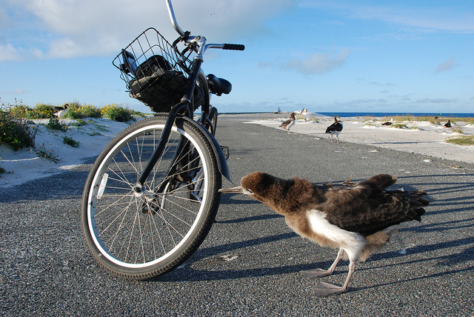
Notes:
I parked my bike and checked my pockets for the three zip-top plastic bags I had brought and checked my watch.

Slide 3
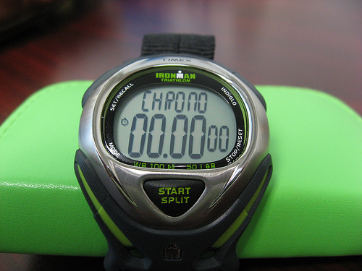
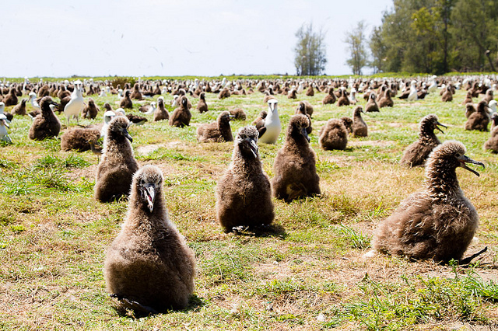
Notes:
I pushed the mode button until I had a chronograph setting. I pushed the button again and stepped out into the hot sun.

Slide 4
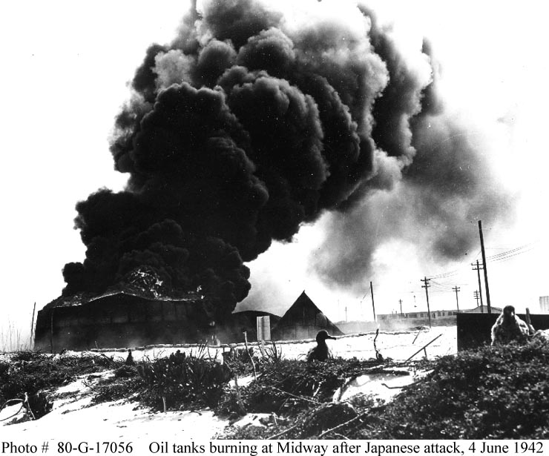
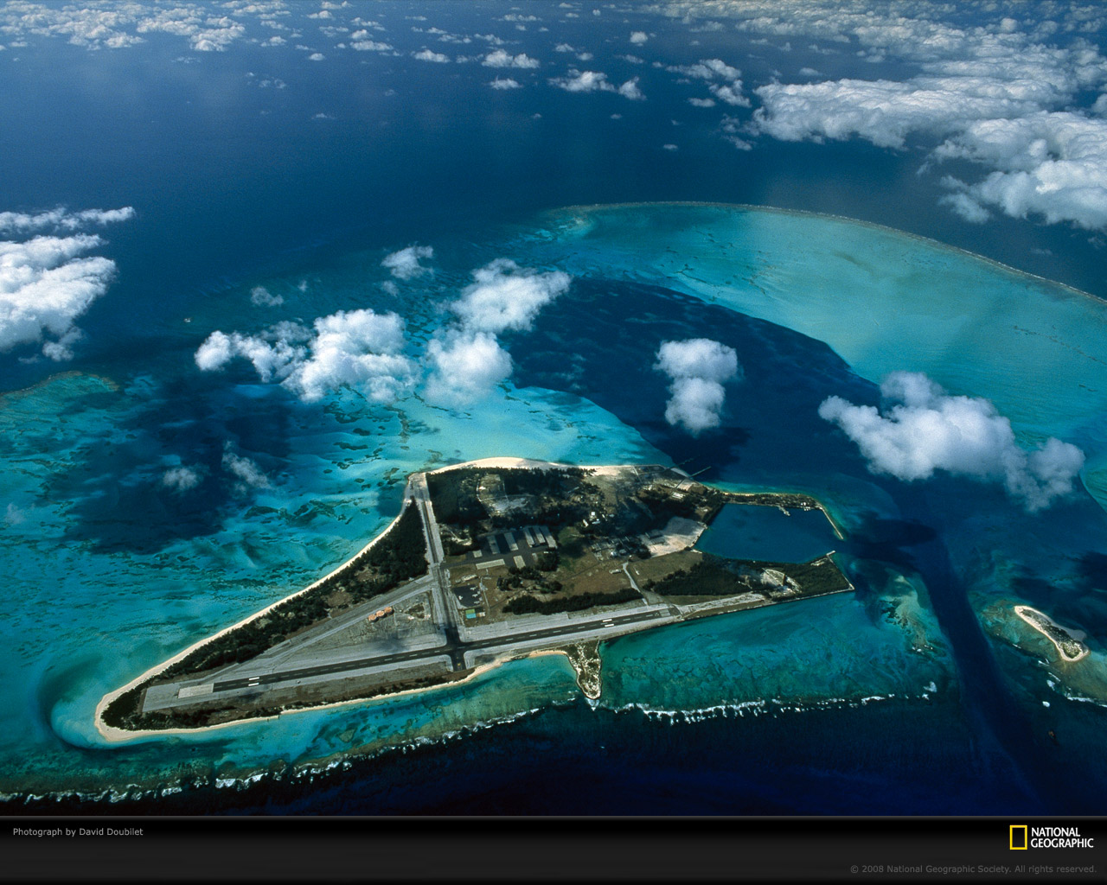
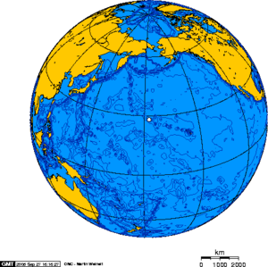
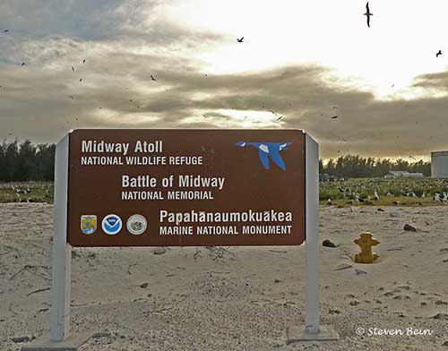
Notes:
I was on Midway Atoll, a tiny 2.6- square-mile speck out in the middle of the vast Pacific Ocean. Midway is most famous for the pivotal battle that took place in June 1942 and turned the tide of the war against the Japanese.

Slide 5
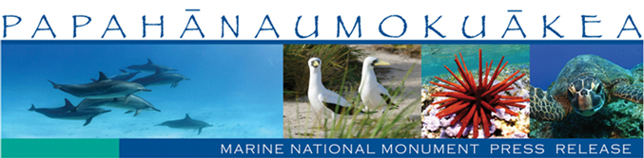
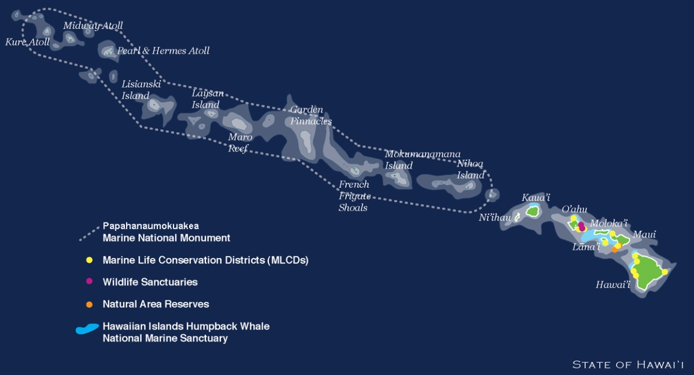
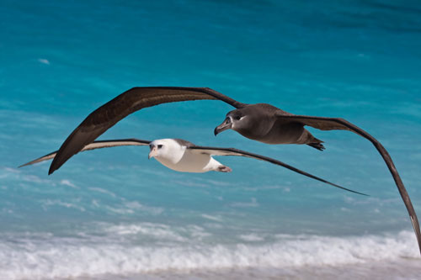
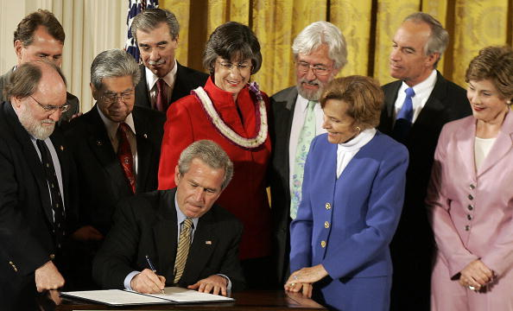
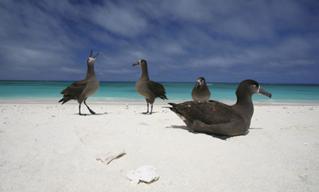
Notes:
Today, thanks to the foresight of President George W. Bush, Midway is part of Papahanaumokuakea Marine National Monument a 1,500-mile-long chain of islands stretching northwest from the better known main Hawaiian Islands.
Midway is second to the end of that chain.

Slide 6
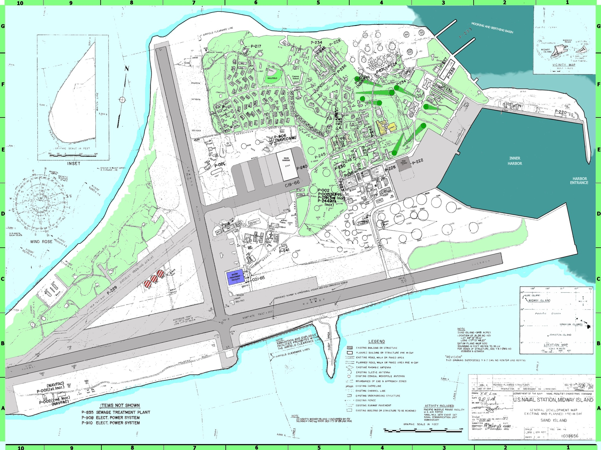
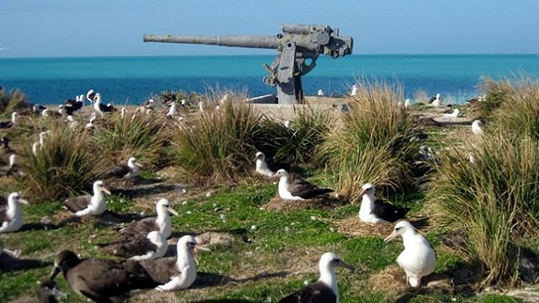
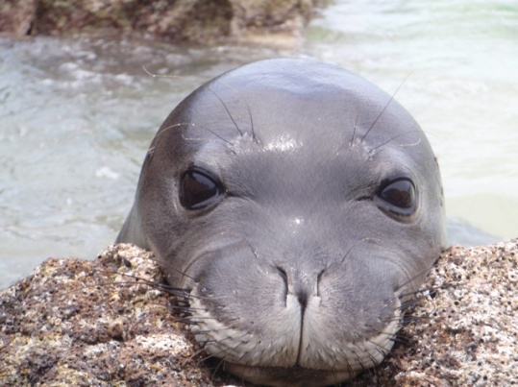
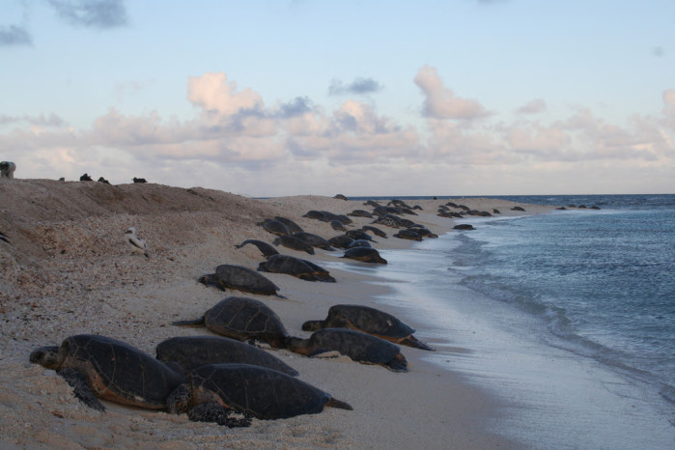
Notes:
The military left back in 1996, and since that time Midway has been recuperating from the 5,000 people who used to live, work and play on the island. Slowly but surely the Hawaiian monk seals, green turtles and seabirds have been coming back in increasing numbers.

Slide 7
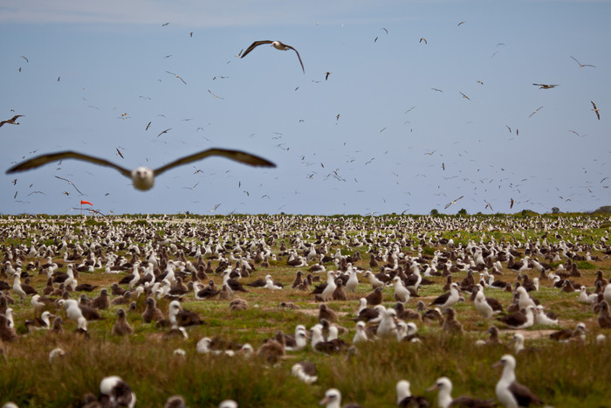
Notes:
Out in the sun all around me were albatross chicks. Tens of thousands of them. They were only a week or two from fledging and had been fed religiously by hardworking parents for months and months to reach this stage.

Slide 8
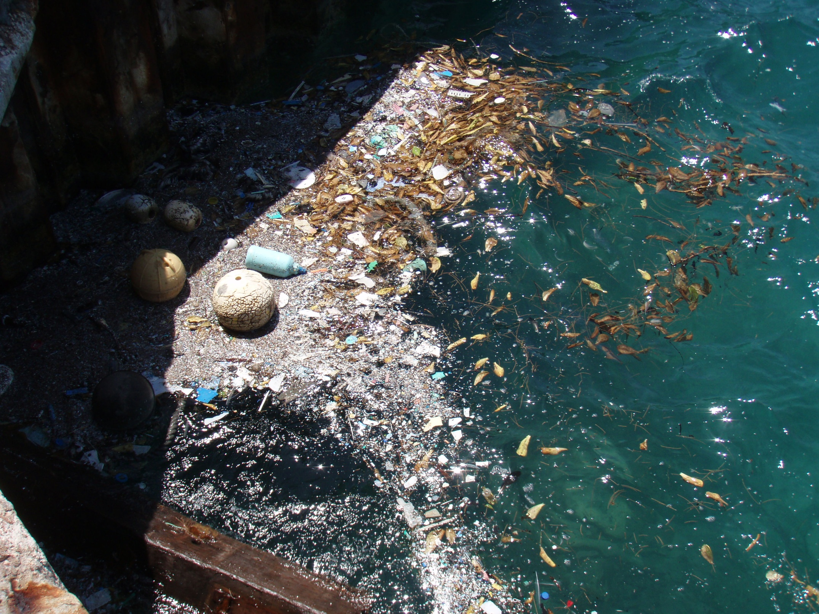
Notes:
Unfortunately, in addition to their normal diet, they were being fed large amounts of plastic. The problem with plastic, aside from being indigestible, is that it floats.

Slide 9
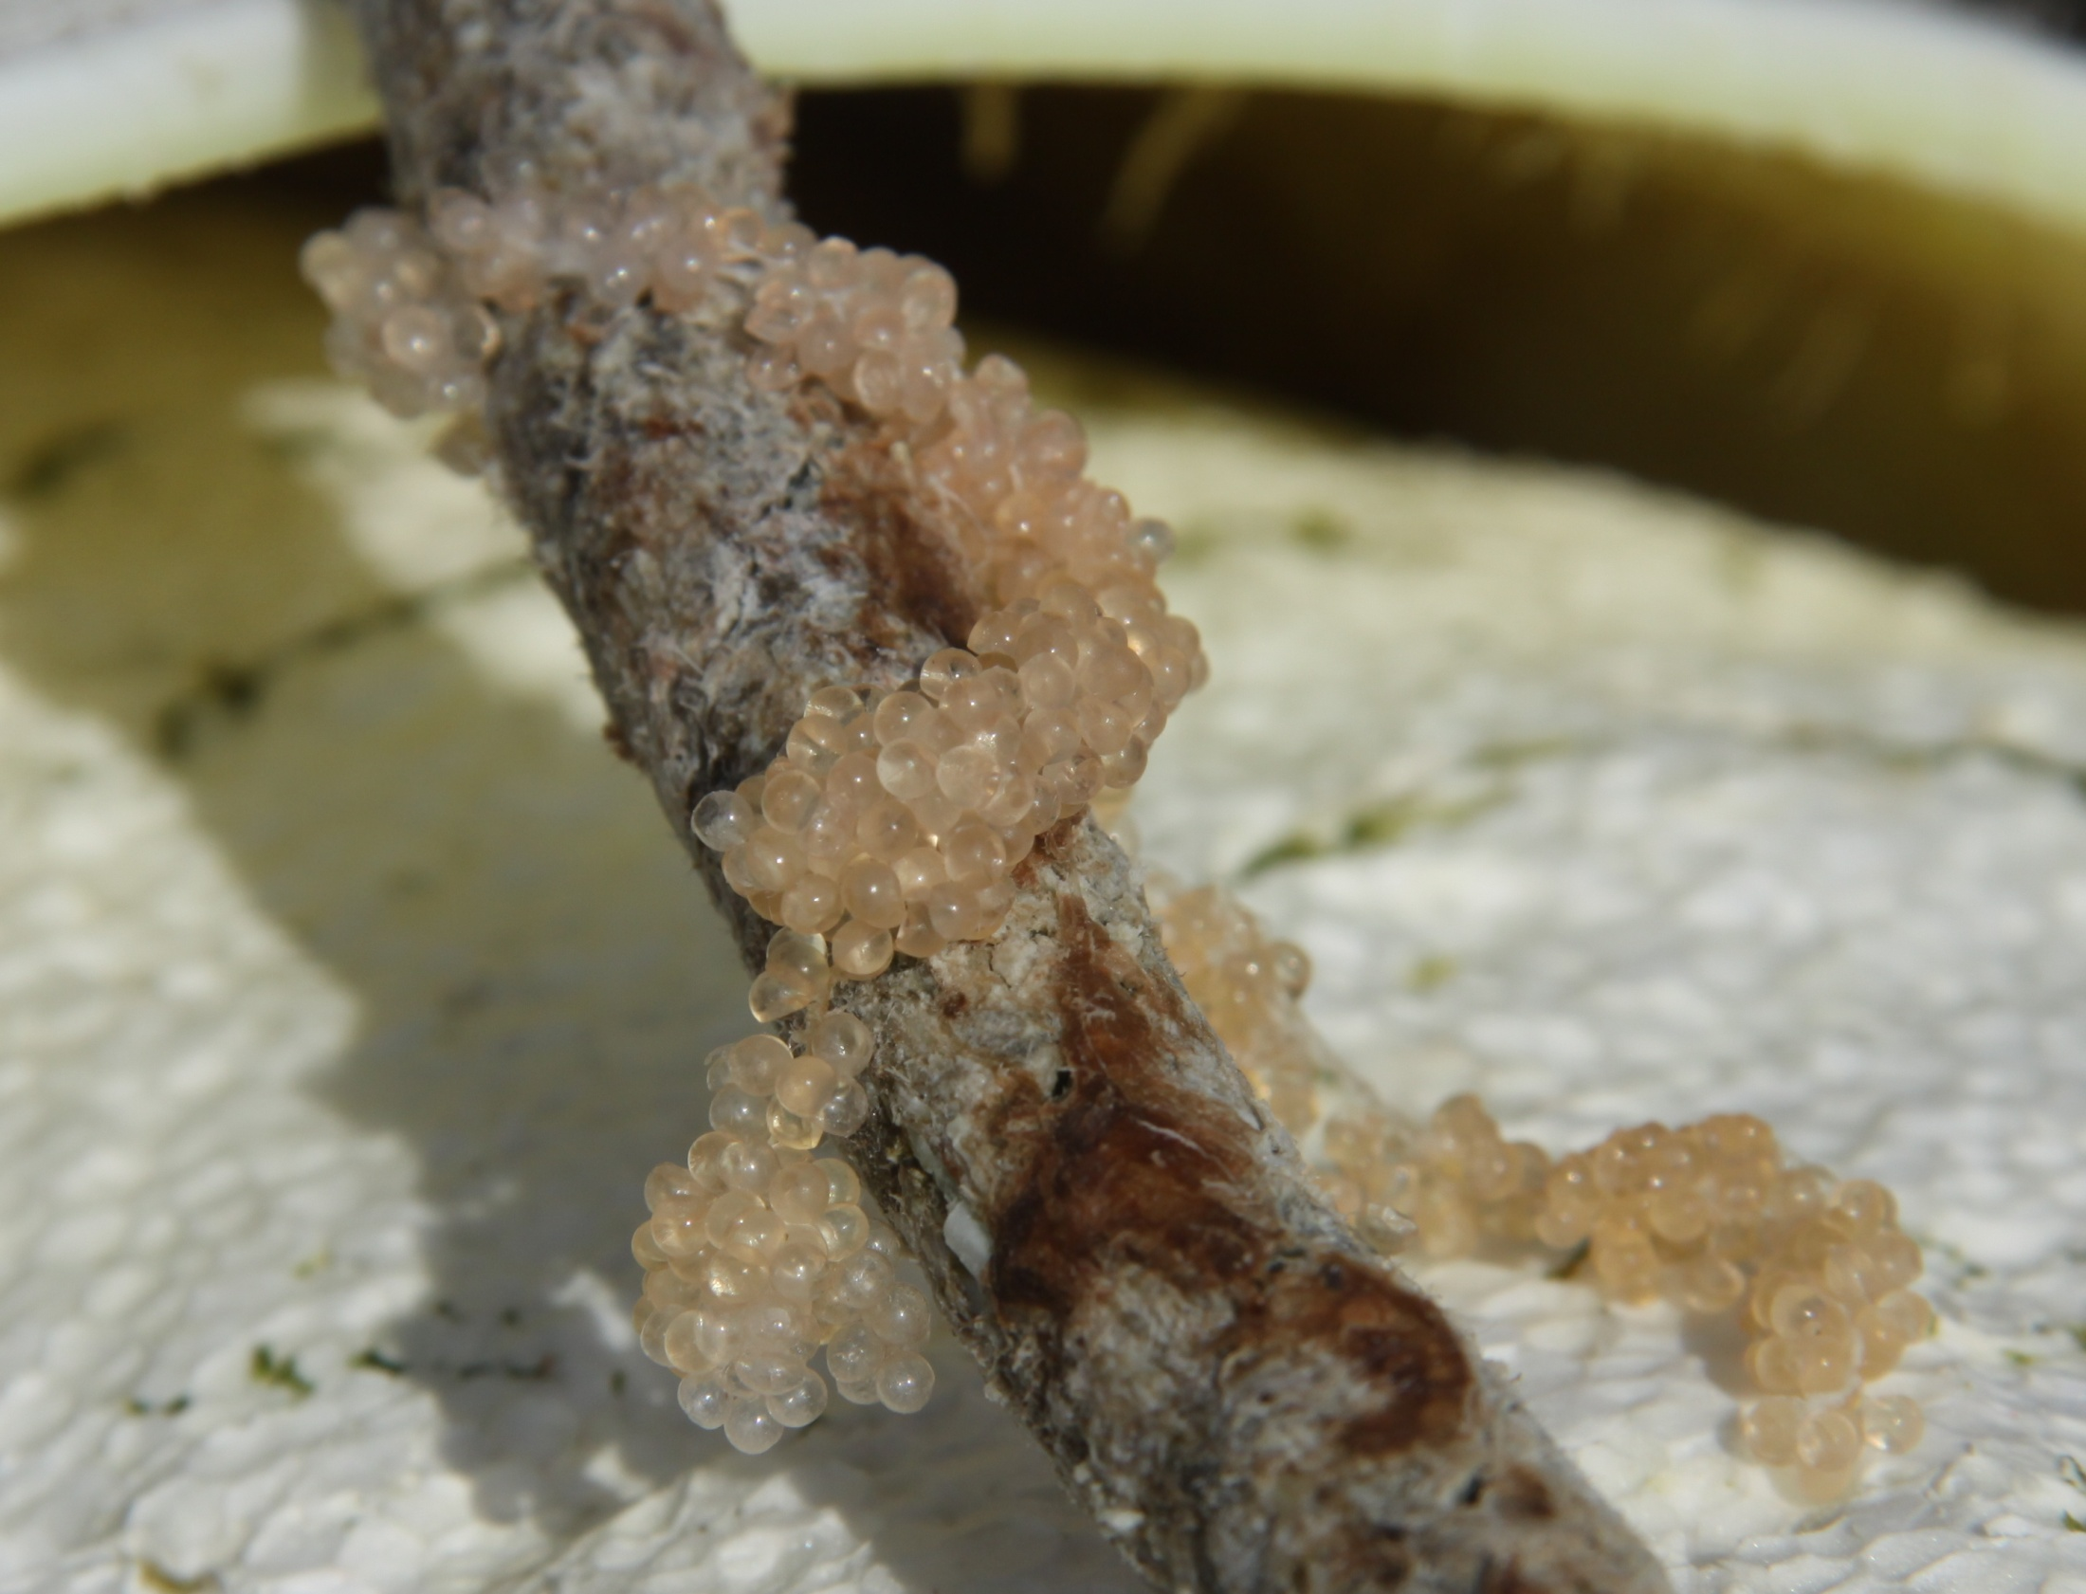
Notes:
Flying fish are prolific egg layers and attach their eggs to whatever floats in the ocean. Flying fish eggs, or eggs of any type, are packed with energy, making them a valuable food source in nature. Albatross parents gobble up the eggs wherever they can find them, regardless of what they might be attached to, whether it is a small piece of kelp, wood or a child's plastic toy.

Slide 10
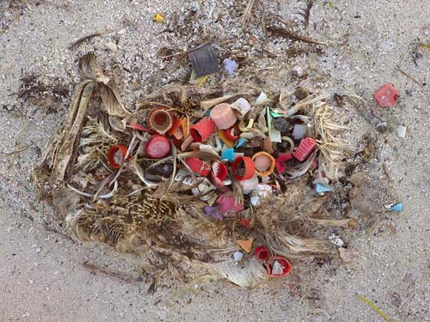
Notes:
One, two, three, four I count as I start walking through the nesting area and picking up plastic bottle caps. Every couple of steps I seem to find them. I am ignoring all the other plastic - just picking up bottle caps.

Slide 11
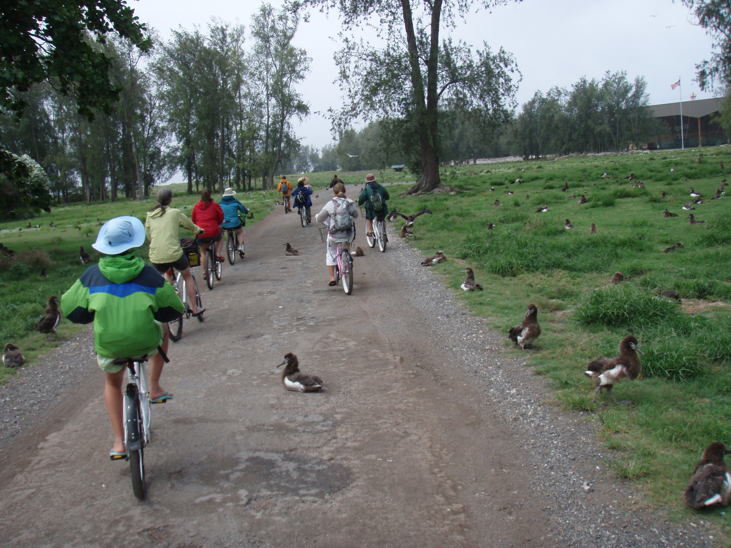
Notes:
I am part of the first group of 12 teachers and community leaders asked to come out to the monument to learn all we can and go back to our respective communities to share what we learn. Eight, nine, 10, 11.

Slide 12
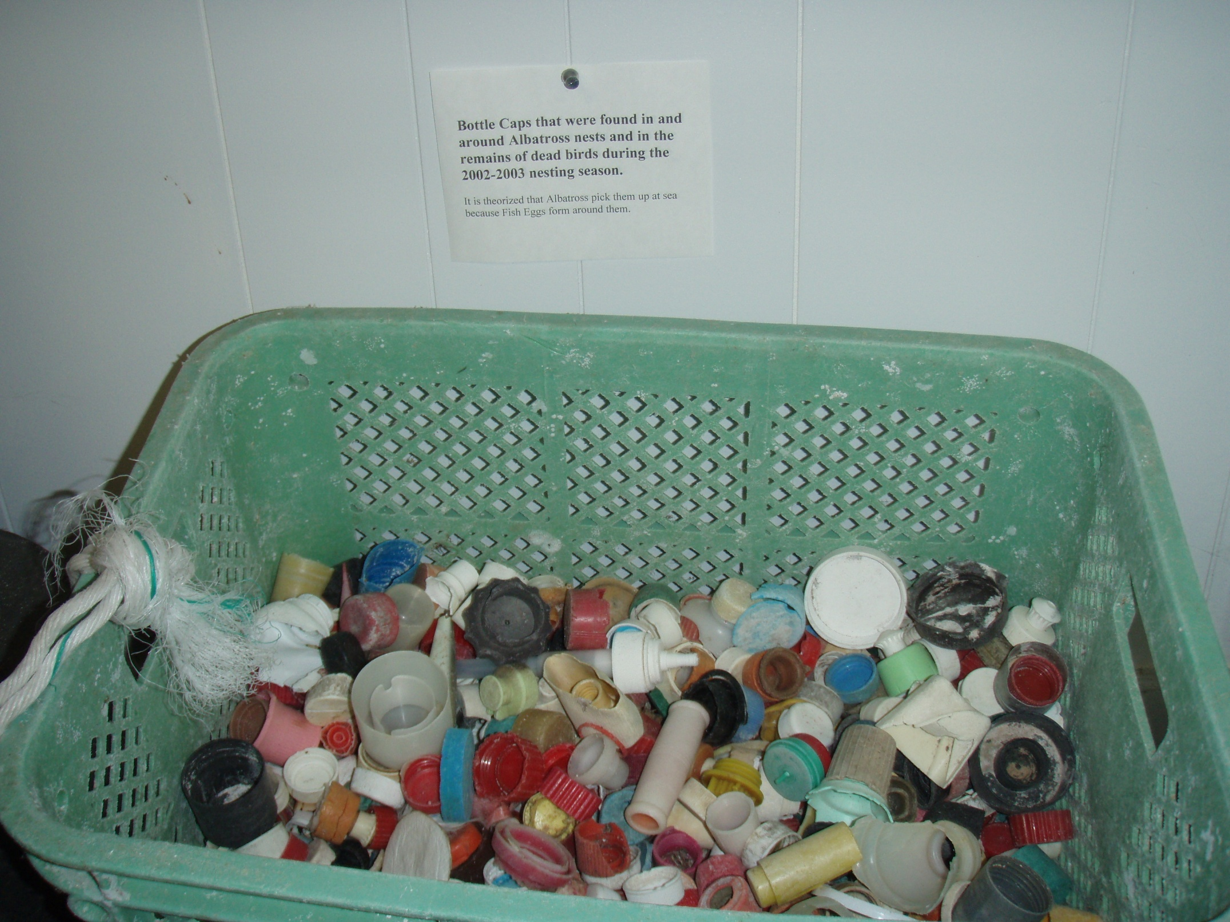
Notes:
We learned earlier from the chief biologist that approximately 4,840 pounds of plastic bottle caps are brought to the island by the parents each year. Yes, that is almost 5,000 pounds of just bottle caps! Bottle caps like the ones off the water bottles you buy and throw away. These are not washed up on shore; they are mistaken for or attached to food for the young.

Slide 13
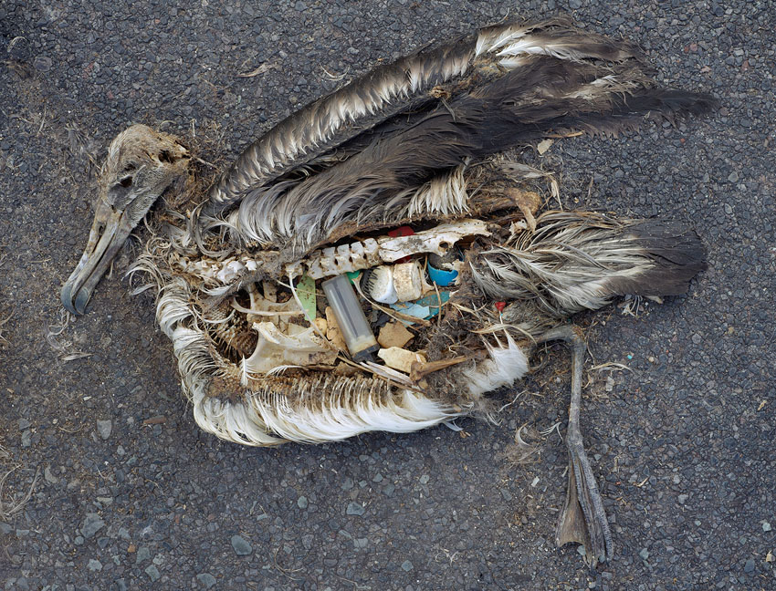
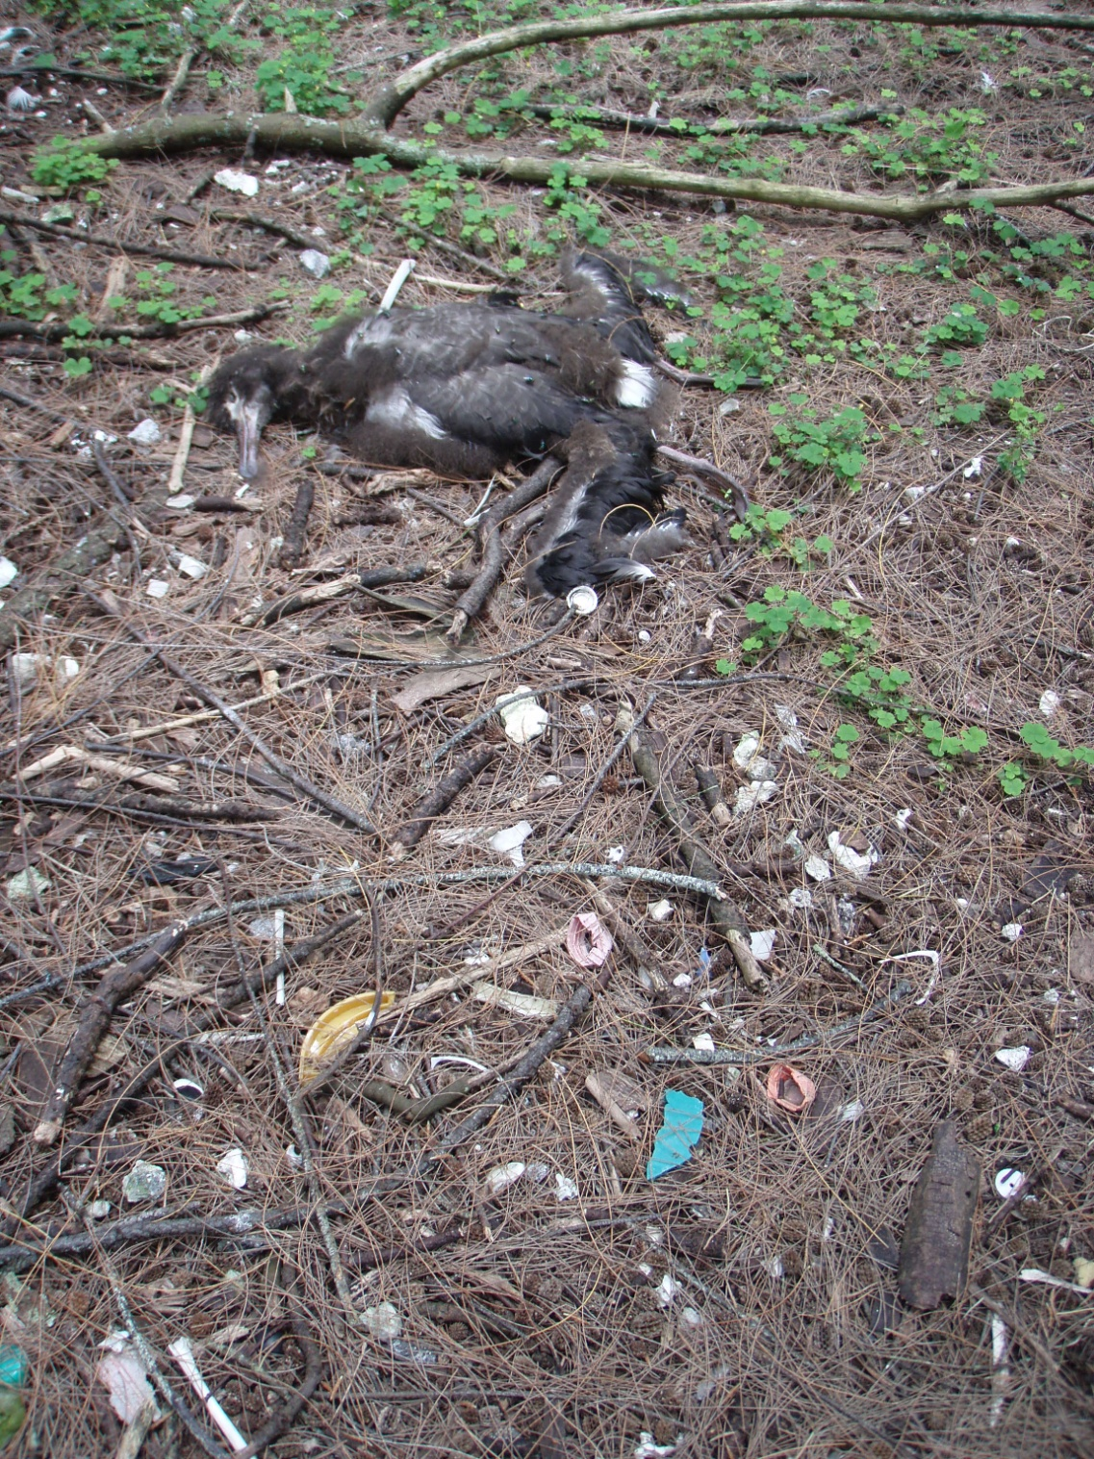
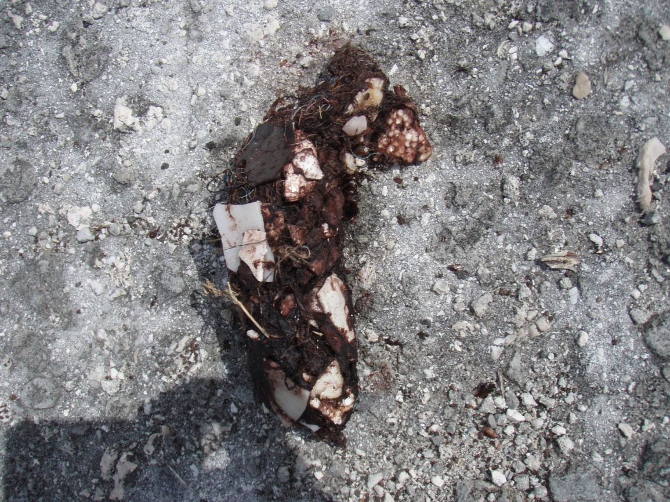
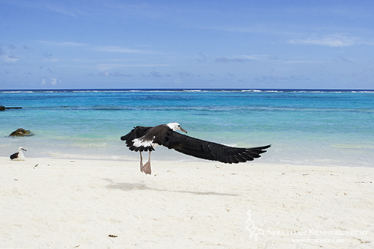
Notes:
Twelve, 13, 14. The lucky chicks are able to regurgitate the sometimes jagged or astonishingly large pieces and survive. The unlucky lie around me almost fully grown and rotting in the sun. Over the past few days I have opened numerous carcasses and have not seen a single dead bird that did not have plastic in the gut. Some were packed with it.

Slide 14
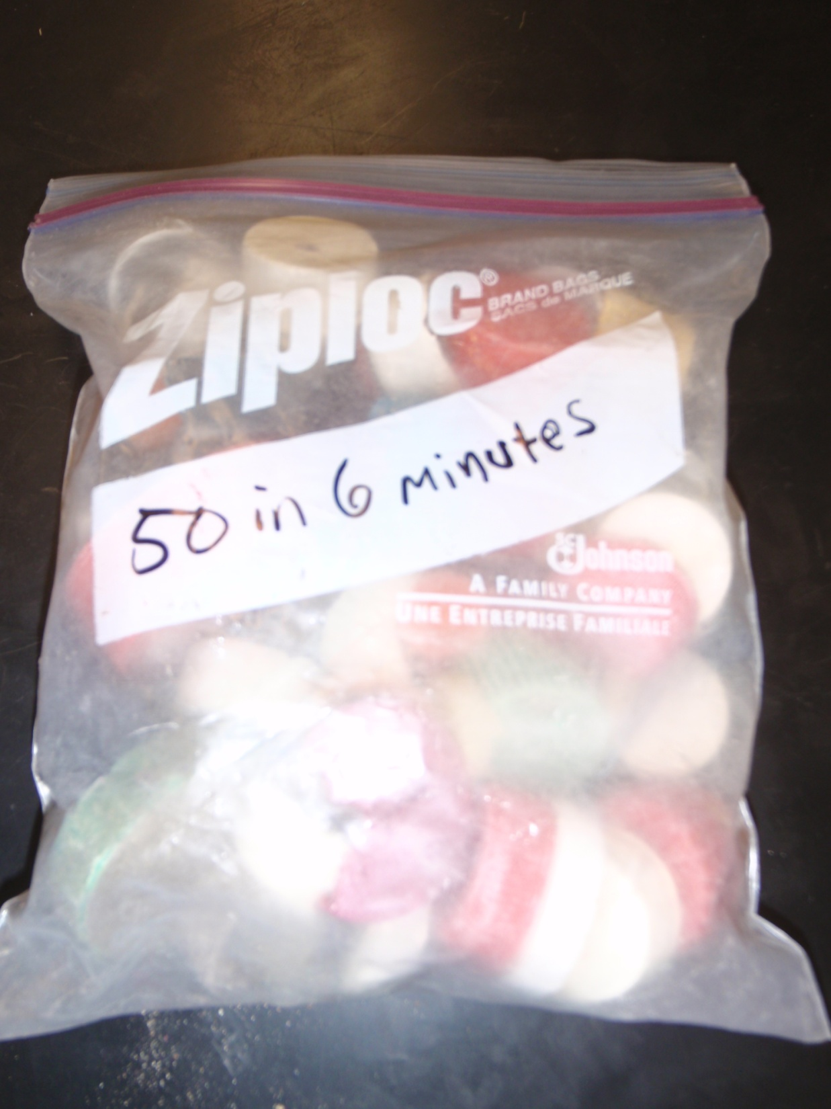
Picture of bag
Notes:
Without rushing, or reaching too close to resting chicks, I had collected 50 caps in six minutes. I sealed the bag and tossed it over to my bike.
Pulling out a second bag I started again - one, two, three

Slide 15
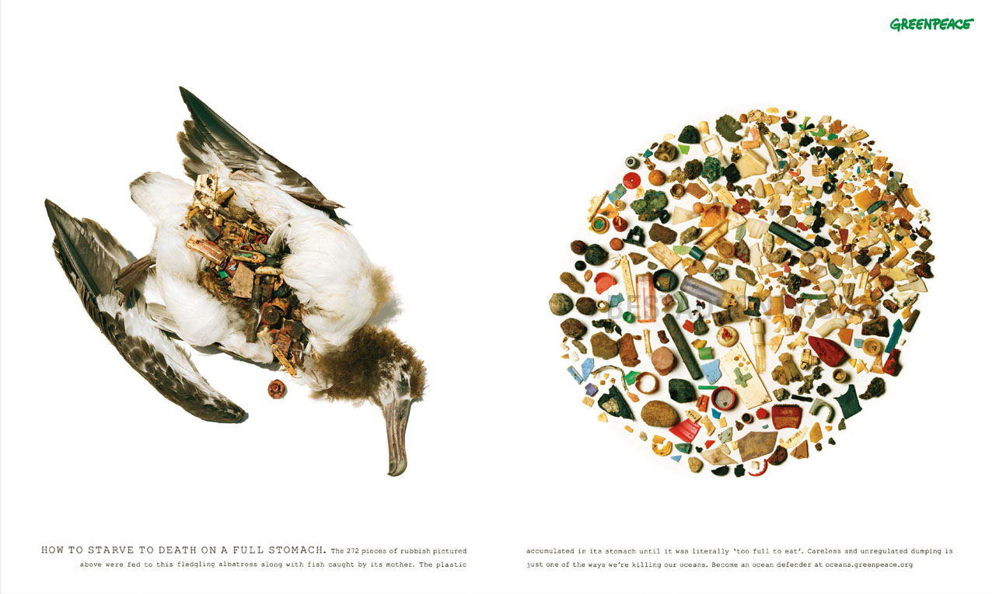
Notes:
Why bottle caps? I teach marine science at a high school in California and over the past several years I have become increasingly aware of the marine debris problem in the ocean. More and more of our plastic just keeps winding up in the ocean. As part of my awareness I looked up the effect on seabirds and saw my first pictures of dead albatrosses with plastic-filled bellies.

Slide 16
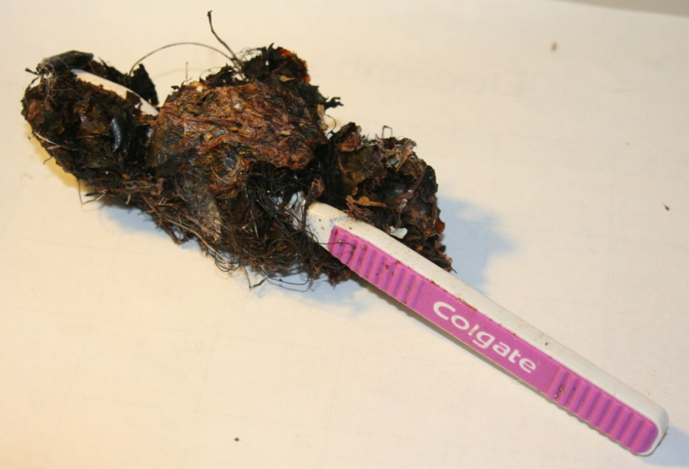
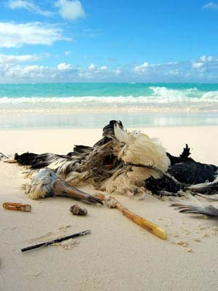
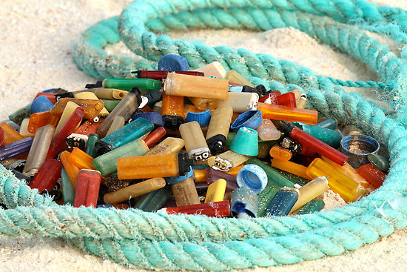
Notes:
The toothbrushes and cigarette lighters really grab your attention. Just type in "albatross" and "plastic" into your Web browser for images and you'll see what I mean.

Slide 17
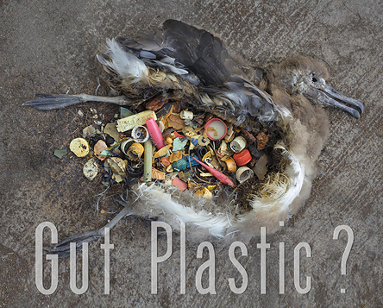
Notes:
But then I started to notice a lot of bottle caps in those pictures, too. I also noticed them littering our campus and knew that when the rains came they would go down the storm drains and into the sea.

Slide 18
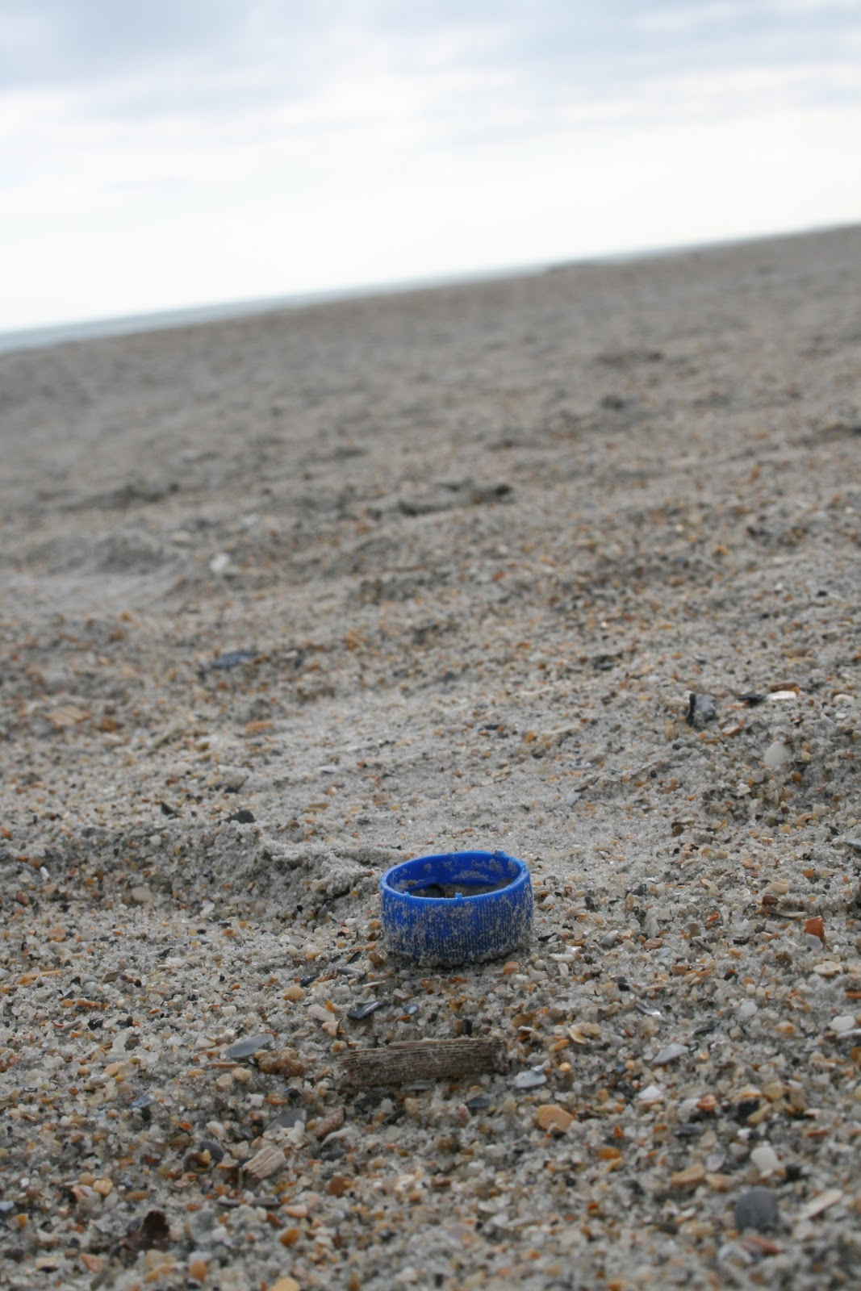
Notes:
Sure enough, last winter I took a trip to the beach and found dozens of them in the streams flowing into the surf.

Slide 19
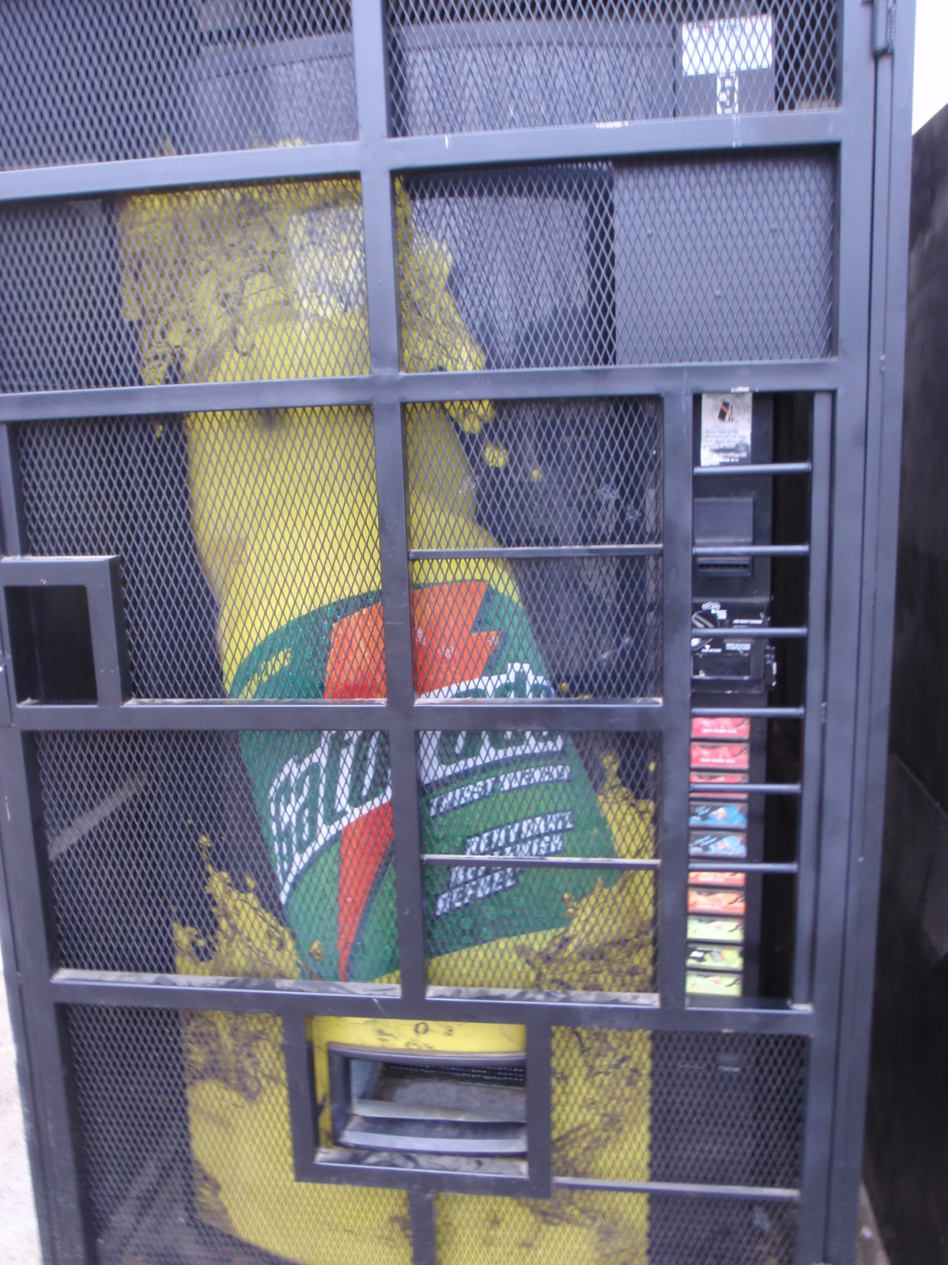
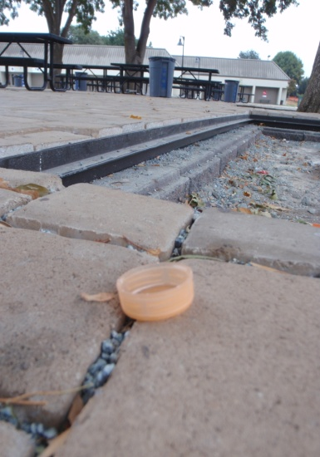
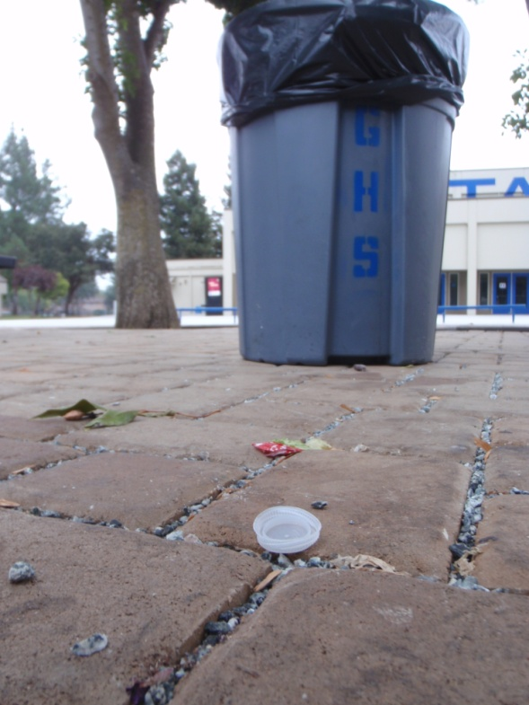
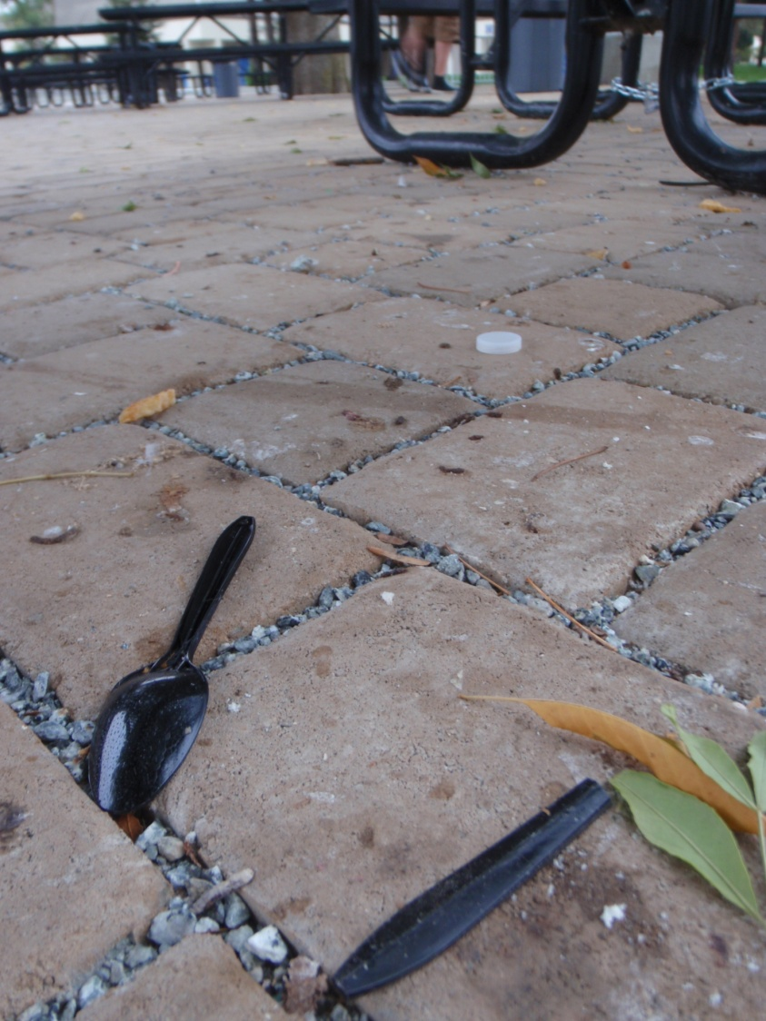
Notes:
I doubt many of my students are throwing used toothbrushes out their windows at home, but they do drink a lot of bottled water and soft drinks, and I have seen the caps on the ground. I have a goal to eliminate our campus as a source of caps that could be killing albatross chicks. It is doable. It is a simple goal.

Slide 20
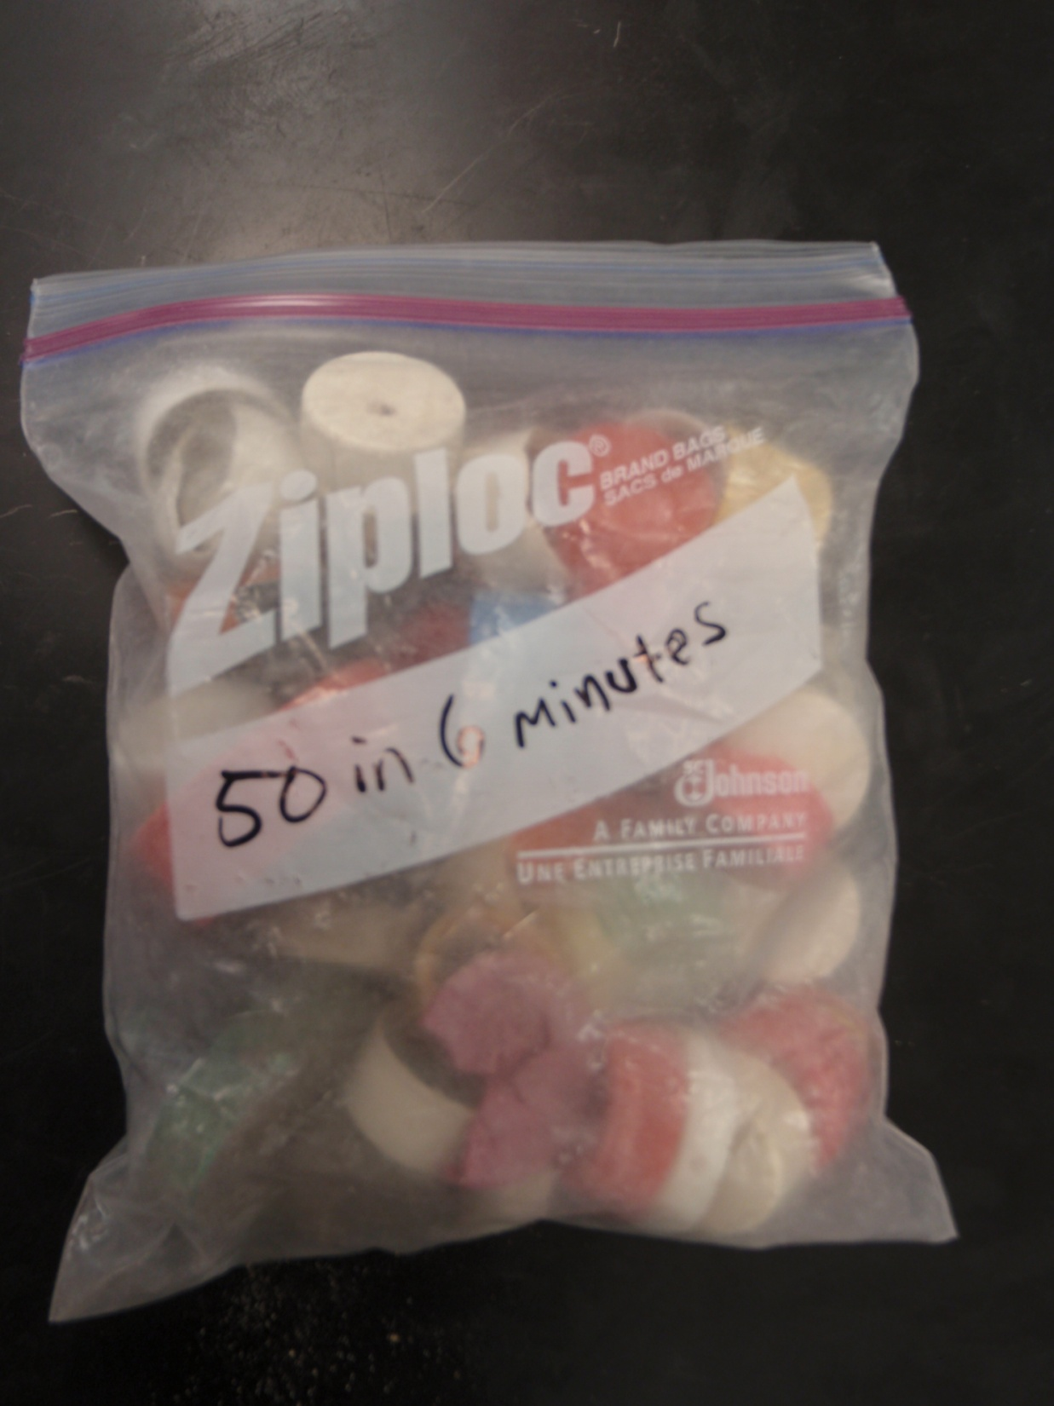
Notes:
By 12 minutes I had filled a second bag with 50 more caps. I pulled out my third bag and kept picking them up. I finished with the last 50 by the 20-minute mark.

Slide 21
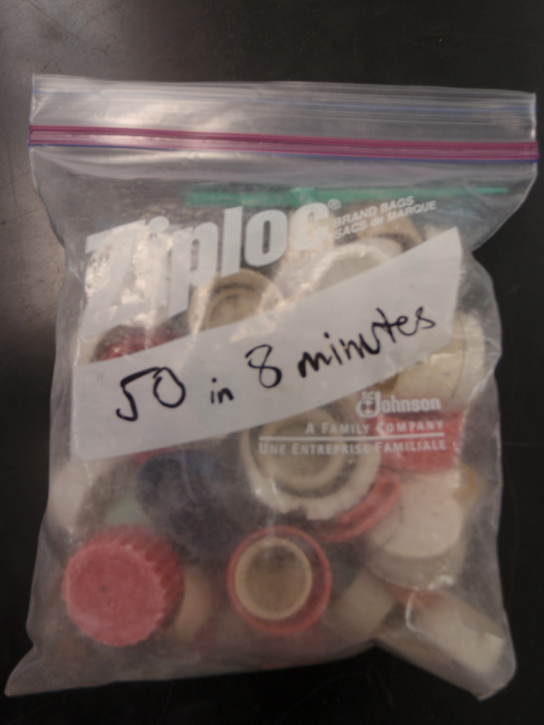
Notes:
On the last cap I also picked up a three-inch, green plastic sword from inside the rib cage of a dead chick. I couldn't resist it. I don't know if I was just shocked that a child's toy had probably killed one of the most majestic flying creatures on our planet or if I was taking up the sword in this cause.

Slide 22
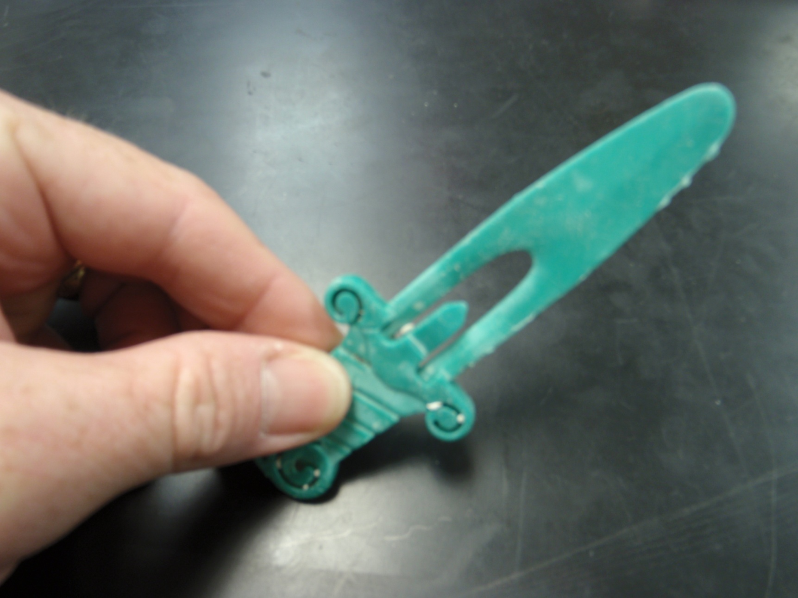
Are you ready to join this battle?

Slide 23
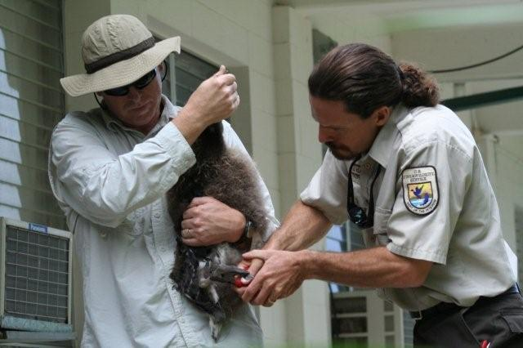
Teacher Jeff Manker helping Biologist John Klavitter place a leg tag on a juvenile Laysan Albatross for an on-going long term survivability study

