Slide 1
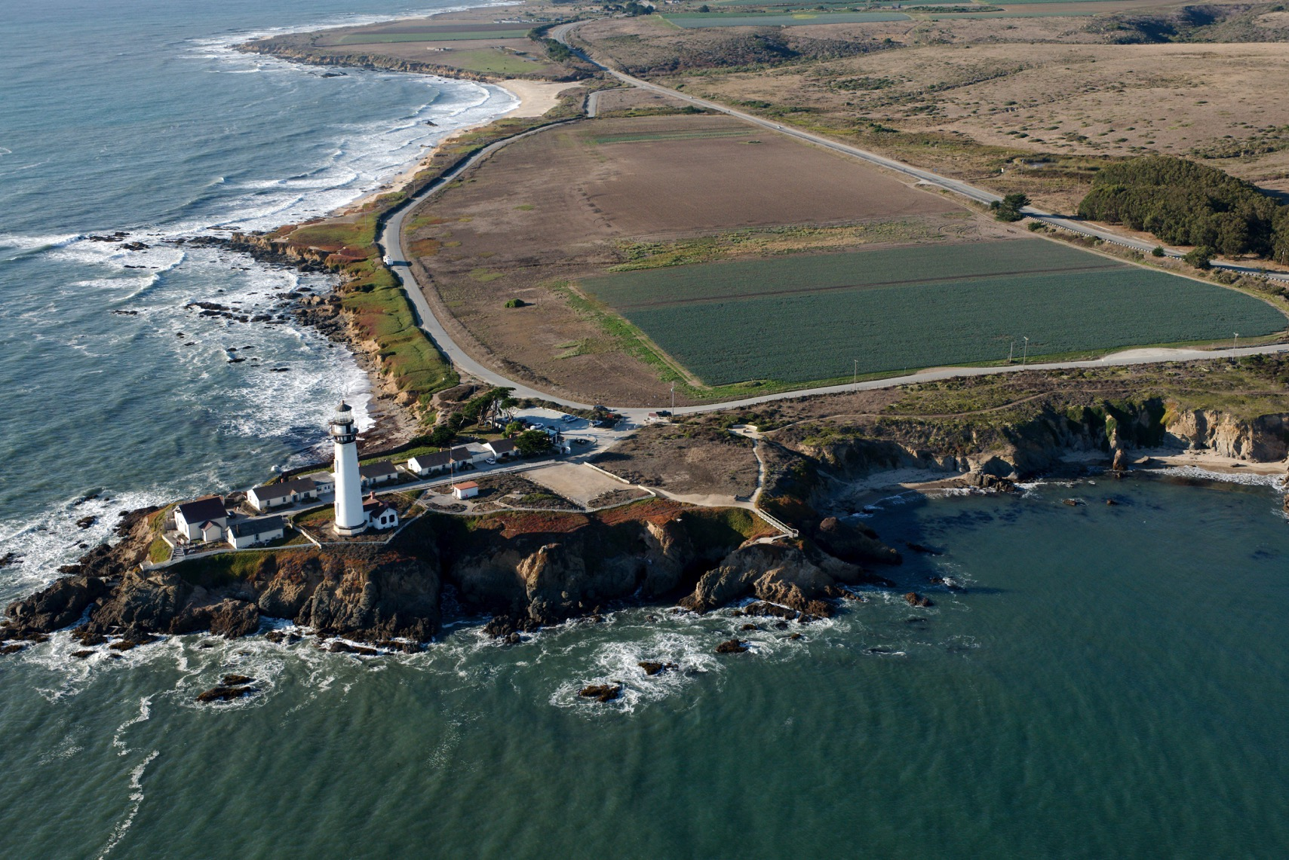
Notes:
Pigeon Point Lighthouse and agriculture. Nice refraction, reflection, and diffusion example.
Copyright (C) 2002-2014 Kenneth & Gabrielle Adelman, California Coastal Records Project, www.californiacoastline.org

Slide 3
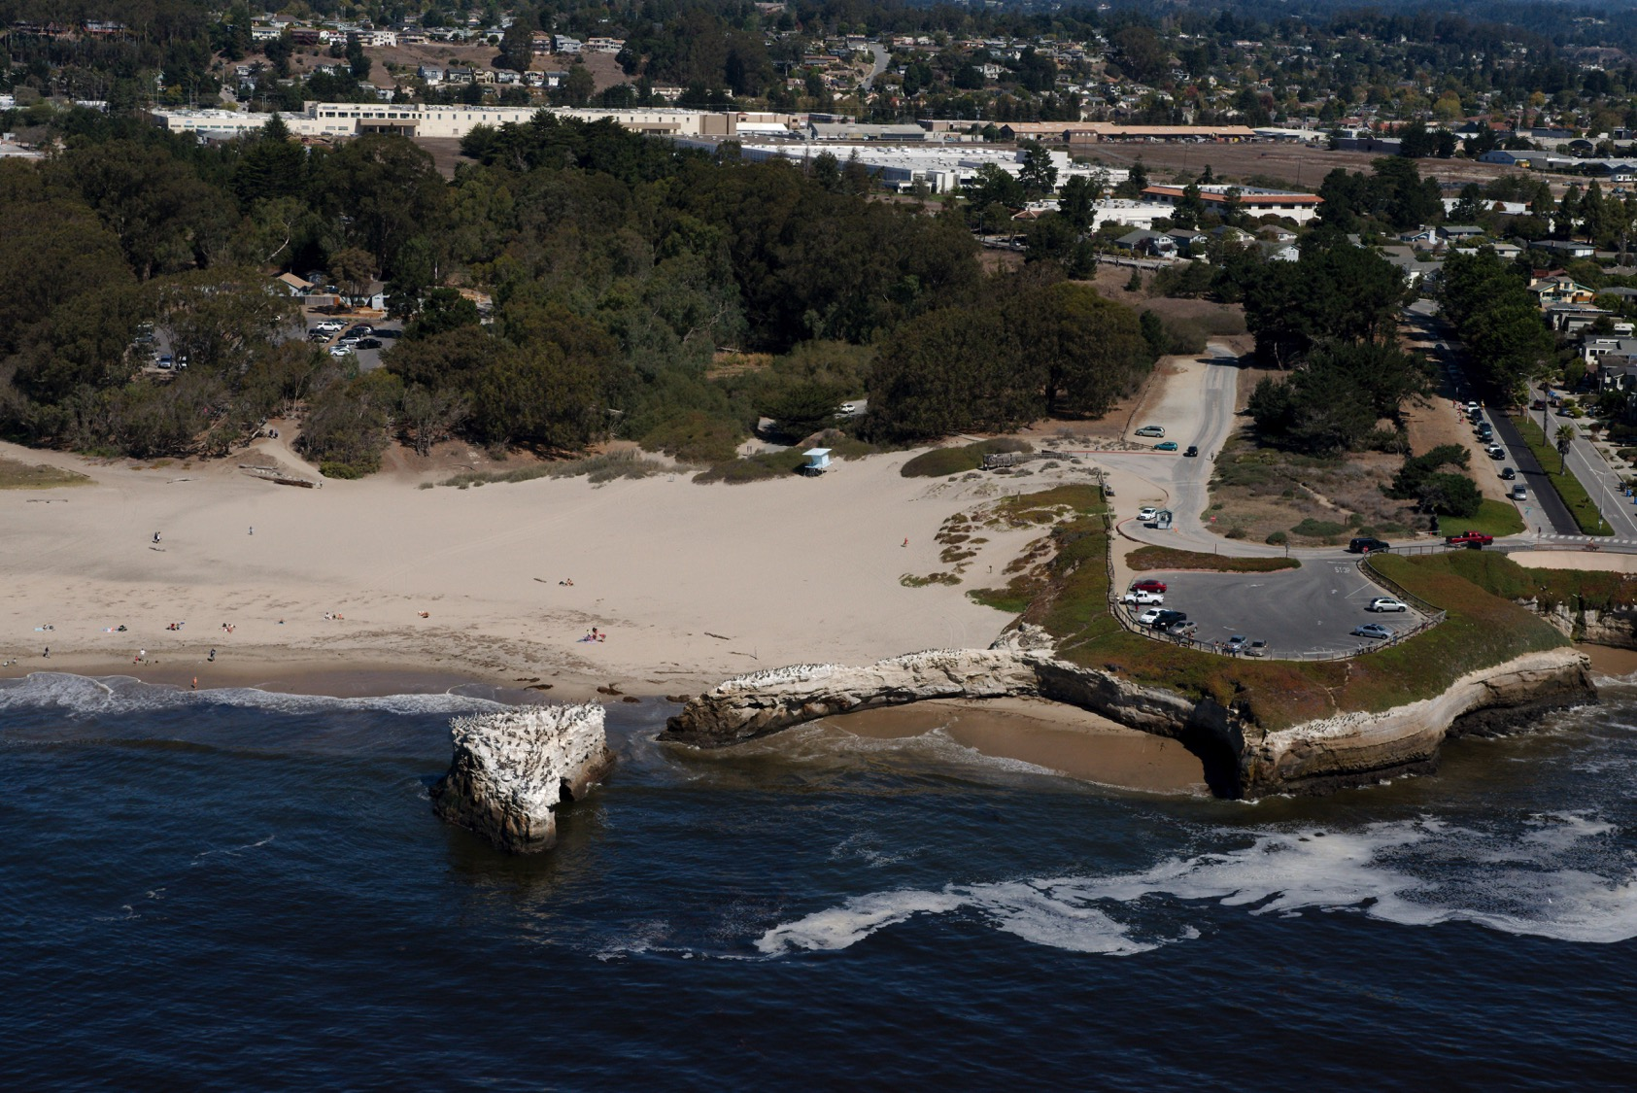
Notes:
Copyright (C) 2002-2014 Kenneth & Gabrielle Adelman, California Coastal Records Project, www.californiacoastline.org

